Slide 1

14 July 2015
Notes:
MS server 2003 end of life is approaching.

Slide 2
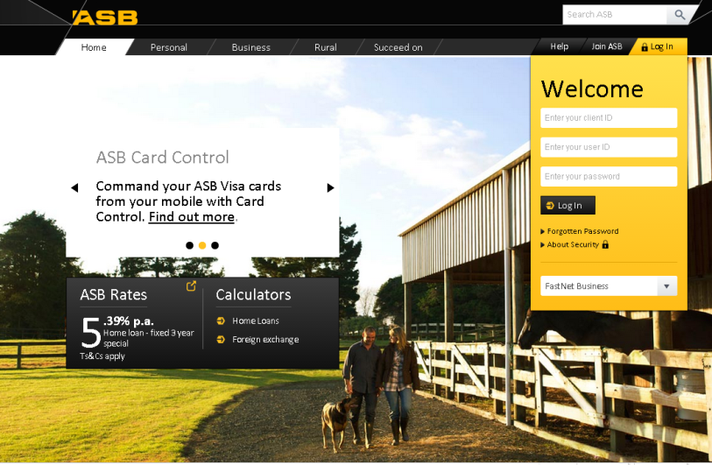
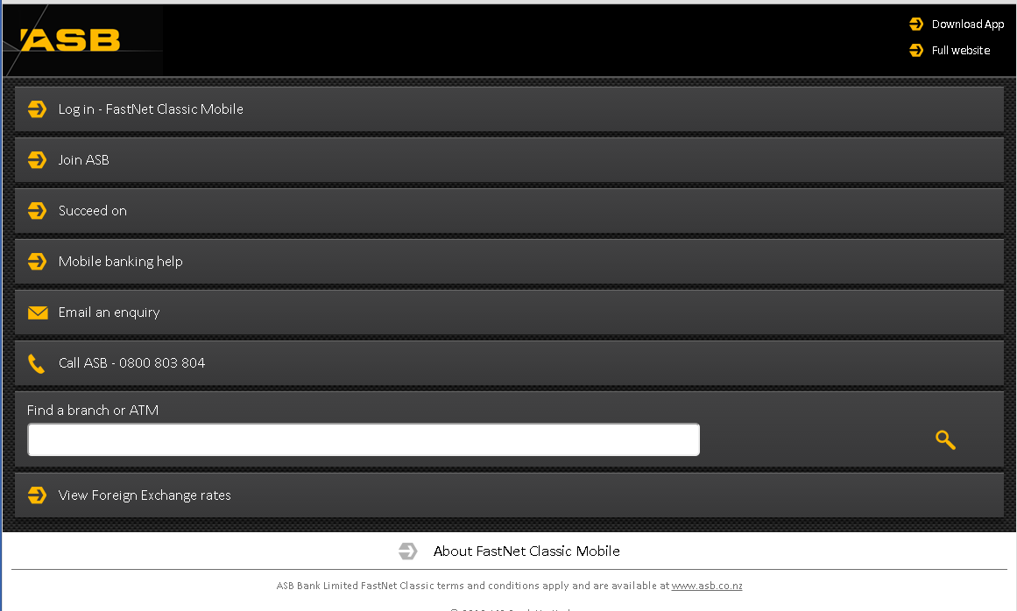
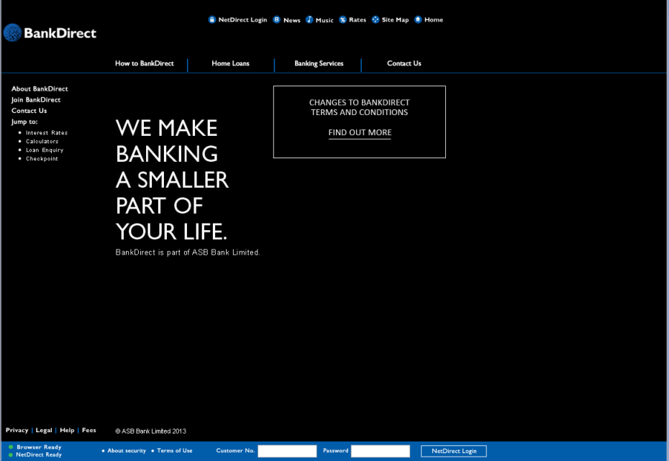
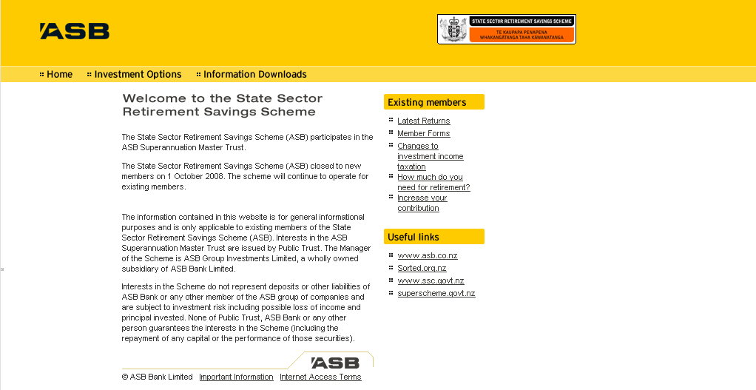

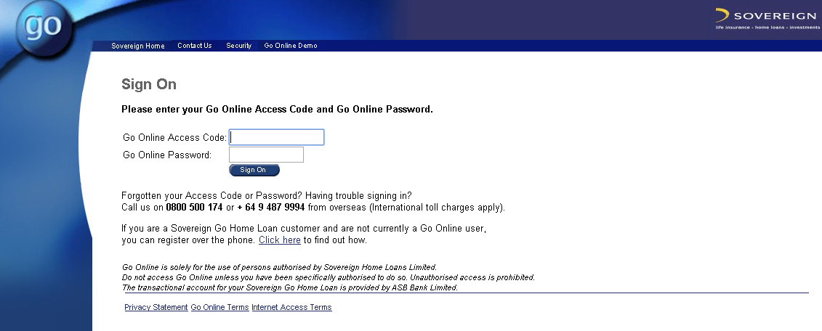

Notes:
Leading next:
I am going to talk about only one site – ASB Web.

Slide 3
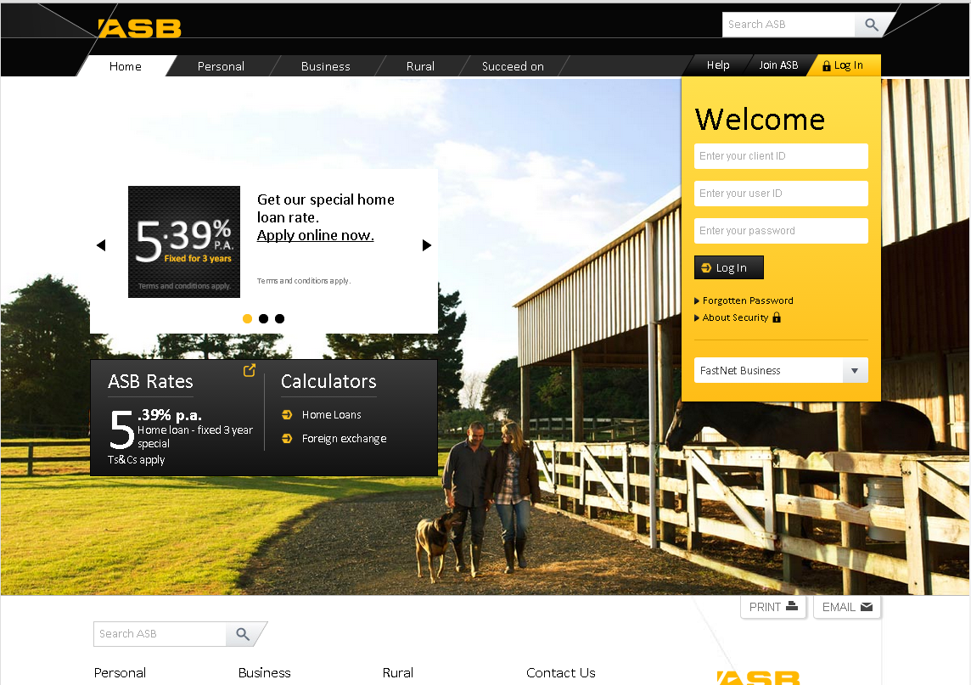
Notes:
Before I started, my initial reaction was – what is the big deal? It is only websites.
Then I heard rumours such as – no doco, no overarching architecture, ad-hoc dev, missing source code, com+, vb6, nobody has definite knowledge of asb web, etc.
So, what does it look like?
Size – 2600+ links, 200+ components, ~20 connection strings, ~12 databases.
Lifespan – dated back in 2002 to current.
Mix of technologies – com+, vb6, c#, .net1, .net2, java.
Deployment – file copy, dynamic publish real-time to PROD.
Ownerships – different business units own different parts of the site.
It is supported by only two devs.
Because of what I heard, I started to build up this assumption that ASB Web is difficult, not-understandable, messy, spaghetti.
But wait a minute, how can two developers handle this massive site with no documentation, no source code, no architectural structure?!
Leading next:
That made me want to take a closer look, and the more I studied it, the more I felt ASB Web is actually a hybrid microservices!

Slide 4

“
”
Notes:
It looks like a hybrid microservices because:
ASB Web is consisted of 200+ small apps.
Each folder under the site is actually an app, some big, some small, each one is responsible for one business feature.
Most of these apps are simply static contents. Complicated ones all have source code in TFS. So no doco, no problem, just look at the source!
They use different languages but mainly in Microsoft stack.
Apps can be deployed separately. Some deployed straight to PROD.
I am not saying that ASB Web is strictly a microservices architecture. But by changing my mindset, I was able to see things differently therefore tackled the problem from a completely new angle.

Slide 5




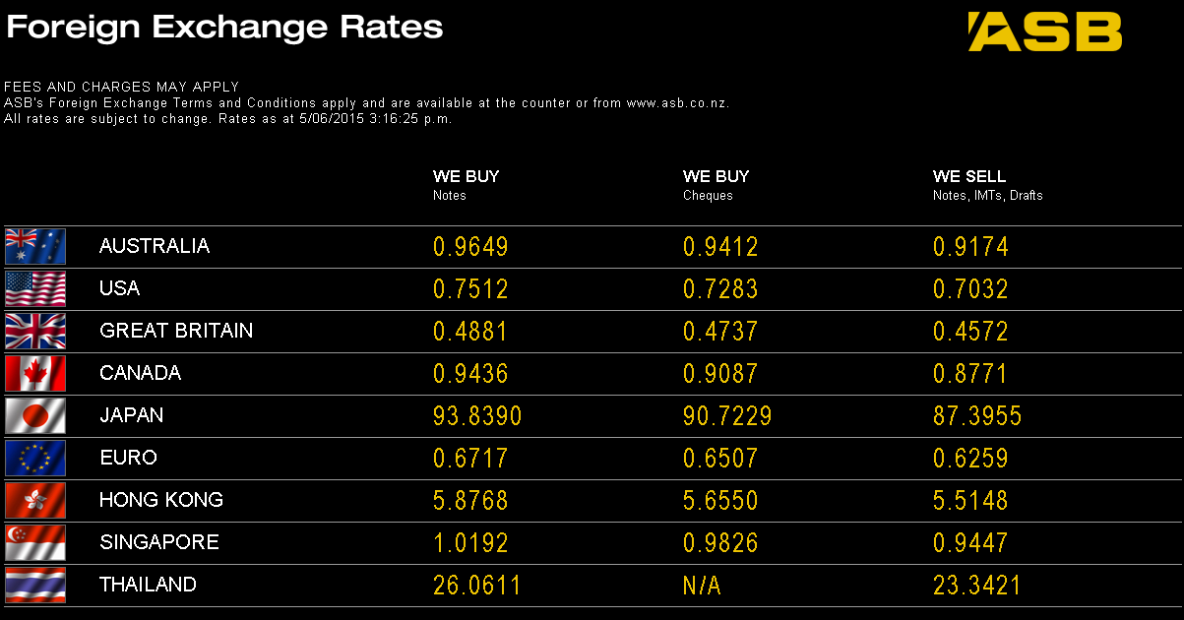
Careers
ASB Football
Social banking
Multiple languages
Bus focus
contactless
Auckland Summer

Slide 6
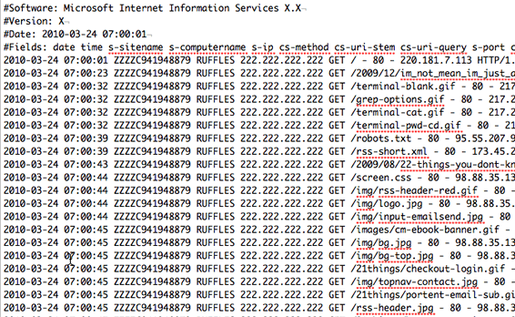


Testing
Manual test
Test server
Notes:
After we finished the upgrade, we needed to test it
It is massive, no selenium auto test scripts.
Testers need to prioritize their test cases, test manually by priorities.
Need a quick, automated sanity check on all links.
How did we do that? IIS logs
We wrote a program to:
Step1 extract all the urls that hit ASB Web and summary them by hit count.
Step2 reconstruct those urls and hit our test server to see if any mismatch.
But one problem: IIS log files are huge!
Across 24 machines, each machine has 700+ logs, each log ~48mb, total of 100+GB per month.
Over 7 million urls per month that hit ASB Web.
First try step1 – 4 minutes per log. If run non-stop 24hr a day would take up to 46 days to parse only one month’s data.
So I tweaked the program a bit cut it down to ~6 hours. But this was still too slow.

Slide 7

50MB p/log, 100GB p/m, 12 months
4minutes p/log, 46days p/m

Slide 8

Notes:
Async has come to rescure. Cut it down to ~2 hours.

Slide 9

What you believe is what you see
Notes:
Takeaway:
Not often we get to do something from ground-up, using latest technologies.
Quite often, we get to work on something old, and not-so-fancy.
So when we are faced with legacy applications or a problem, we should listen carefully but don’t let assumptions affect what we see.
And maybe VB6 is not that bad after all because it at least does not have semi-colon and if we choose to believe it.

